Slide 1

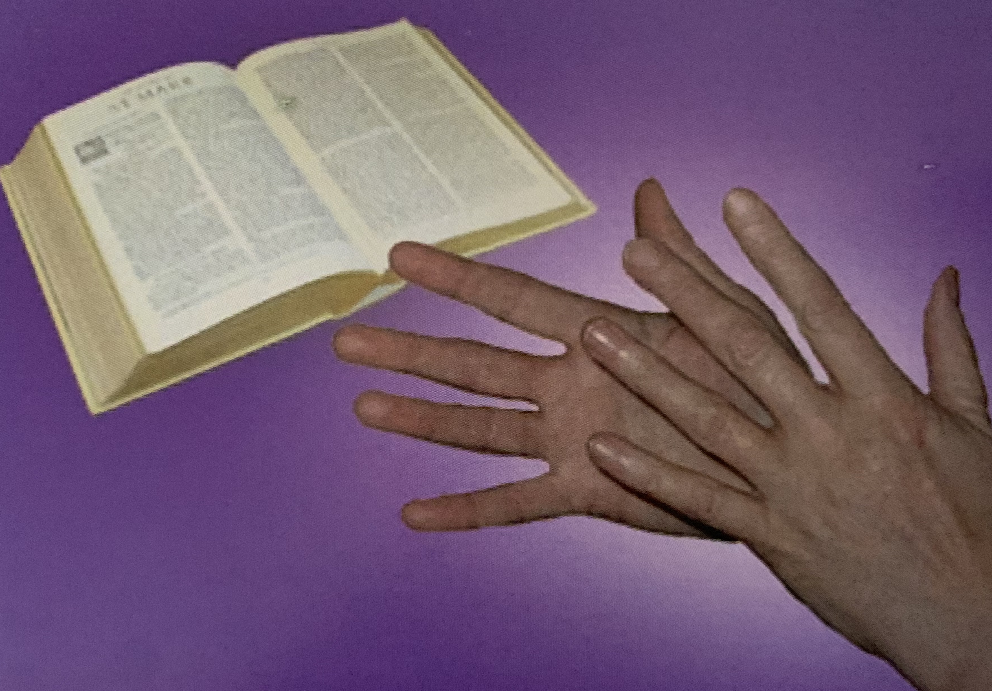

Deaf Awareness Week
4 – 10 May 2026
Registered with

Slide 2
‘Beyond Silence’
Break down barriers and increase accessibility for Deaf people
1
Emphasise the richness of Deaf culture and the importance of recognition
2
Encourage the understanding of diverse communication methods used by the Deaf community, including British Sign Language [BSL]
3

Slide 3
How breaking down barriers can improve accessibility for Deaf people?
Face the person you wish to talk to
Maintain your eye contact
Do not speak too fast or too slowly
Do not exaggerate your mouth movement.
Do not shout
Do not cover your mouth with your hands,
paper or pen or look away often
Do not mumble or speak through clenched teeth
Having a beard and / or moustache can make it harder to lipread
Be aware if in a dull lit room or darkened sky, it is more difficult for them to lipread you
If you struggle to make yourself understood, try using different words / sentences; use gestures; use written words
Ensure you do not stand with a bright light
behind your back, or your face will be in the shadow

Slide 4
The importance of emphasising the richness of
Deaf culture and its recognition
Recognising Inclusion and Empowerment:
Deaf culture helps hearing individuals understand Deaf people are not just individuals with a disability,
but members of a cultural group with their own distinct traditions and way of life.
Empower Deaf individuals by acknowledging and valuing their culture, Deaf individuals can feel more
connected to their heritage and identity, which can lead to increased self-esteem and empowerment.
Foster inclusivity by recognising Deaf culture in an educational setting, workplaces, and public spaces.
This helps create more inclusive environment where Deaf people can thrive and participate fully in
society.

Slide 5
Cultural Preservation and Enrichment:
Preserve unique traditions of stories, art and literature that are passed down through
generations. Recognising the culture helps to ensure its preservation and continued vibrancy
Deaf culture has much to offer the wider community. Its unique artistic expressions such as sign
language theatre and visual arts, which can enrich society’s understanding of diversity and creativity
Learning about Deaf culture, ensures hearing individuals can gain a broader understanding of
different cultures and ways of life, fostering intercultural empathy and respect.

Slide 6
3. Addressing Misconceptions and Stereotypes:
Challenge the disability model to recognise Deaf culture as a distinct culture helps shift the focus
from deafness as a disability to a cultural identity, challenging the medical model of deafness
Promote to understand and respect for Deaf culture, stereotypes and stigma associated with
deafness can be reduced, leading to a more inclusive and supportive society for Deaf people
Highlight Deaf culture and sign language can raise awareness about the needs and experiences of
Deaf people, encouraging the development of inclusive policies and practices

Slide 7
4. Importance of Sign Language:
Deaf culture is deeply intertwined with sign language, which is a unique and complex language in
its own right. Recognising sign language as a language is crucial for the preservation and
promotion of Deaf culture
Promote and advocate for bilingual education, where sign language and English are used in
schools, can empower Deaf learners to achieve their full potential
Provide access to sign language interpreters in various settings, such as workplaces, healthcare
facilities, and in education settings. This is essential for ensuring effective communication with
Deaf people

Slide 8
Understand diverse communication methods used by the Deaf community, including British Sign Language [BSL]
The Deaf community uses a variety of communication methods, with British Sign Language [BSL] as the primary one in the UK. Other methods include lip reading, fingerspelling and written communication.
BSL is a visual-gestural language with its own unique grammar, vocabulary, and syntax, distinct from English.
Communication Methods are shown on the next slide………………………..

Slide 9
British Sign Language:
A visual language that uses hand shapes. Facial expressions, body language and lip patterns to convey meaning. It has its own distinct grammar and syntax, separate from English
Lip Reading:
Some Deaf individuals rely on lip reading to understand spoken words
Fingerspelling:
Is used to spell out names of people and places for which there’s not a sign for. It can also be used to spell words for signs that the signer doesn’t know the sign for
Written Communication:
A common way for Deaf individuals to express themselves and understand others

Slide 10
The Catholic Deaf Association hopes you have enjoyed reading how barriers can be broken, recognise culture including the diverse communication methods
We hope you are able to donate to support the CDA
How to donate is shown on the next slide

Slide 11
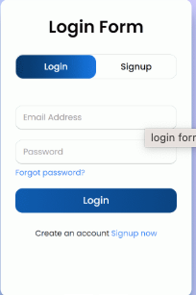
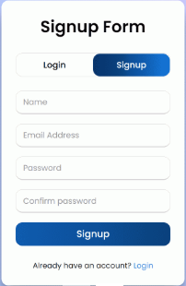
How do I donate to the CDA’s JustGiving page
Go to justgiving.com
1. Log in or sign up
2. Click on ‘Start fundraising’ at the top of the page.
3. Click ‘Yes, I’m fundraising for a charity’
4. Click the blue button ‘Next’
5. Type in ‘Catholic Deaf Association’ as your cause
6. Click the blue button ‘Continue’
7. Continue until you reach ‘How much would you like to raise’

Slide 12
Thank you for your support!

